Slide 1
VETERAN FACING SERVICES – DIGITAL HEALTH MODERNIZATION
1095-B Initial Research Discovery
01 February 2022

Slide 2
Agenda
01
User flow
02
Comparative research
03
Low fidelity landing page
04
Research plan
02-01 Design Review
Agenda

Slide 3
User flow
1095-B DESIGN REVIEW
02-01 Design Review

Slide 4
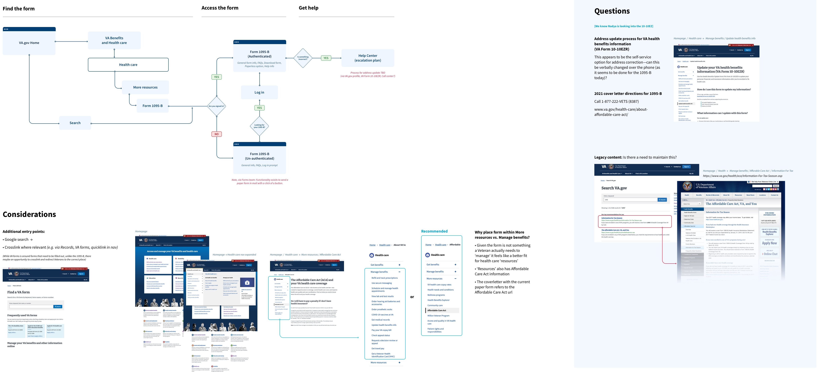
1095-B User flow
See full user flow and considerations here
02-01 Design Review
User flow

Slide 5
Comparative Research
1095-B DESIGN REVIEW
02-01 Design Review

Slide 6
COMPARATIVE RESEARCH
Websites researched
Health Insurance Sites | Financial Sites | Additional Reference sites
United Health Care | Wells Fargo Consumer Banking | IRS.gov
Medicare | Wells Fargo Advisors | VA.gov
PreferredOne | Bank of America | DFAS : Defense Finance and Account Service
Humana | TD Ameritrade | Military.com FAQs associated with tax docs
Cigna | FedLoan Servicing | My Pay
 | Fidelity
 | Coinbase
 | Commerce Loans
 | Chase
02-01 Design Review
Comparative Research

Slide 7
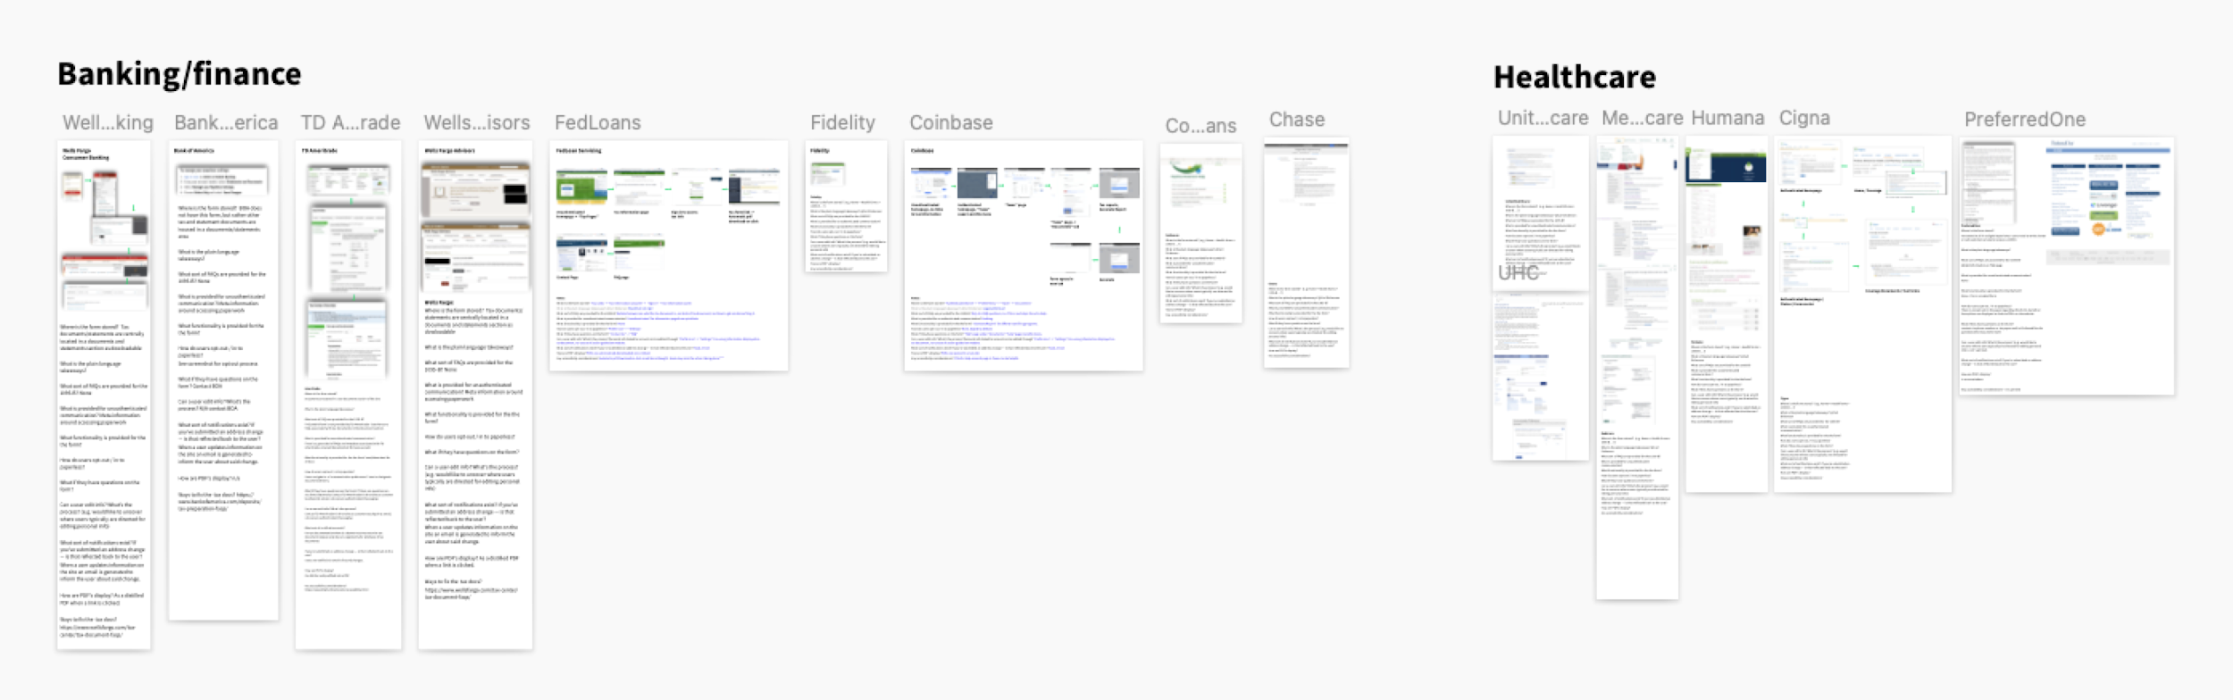
COMPARATIVE RESEARCH
Focus Criteria
For comparative experiences of downloadable tax forms, we focused two comparative sets—Finance (general tax forms) and Health Care (1095-B).
02-01 Design Review
Comparative Research

Slide 8
COMPARITIVE RESEARCH
How might we?
How might we solve for document management storage within the VA?
How might we solve for bad address issues (or even account data issues?)
How might we move to a paperless opt in system?
How might we integrate better contextual information around documents?
How might we utilize alerts as a method of communication for timely manners pertaining to document releases?
*Some of these items will be beyond MVP. We used these questions to guide our thought and research holistically.
02-01 Design Review
Comparative Research

Slide 9
COMPARITIVE RESEARCH
Key themes
02-01 Design Review

Slide 10
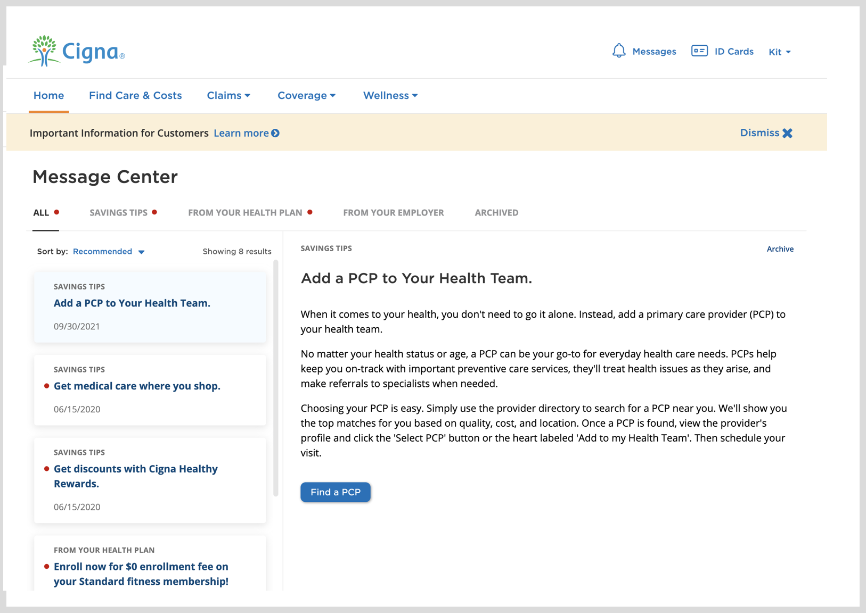
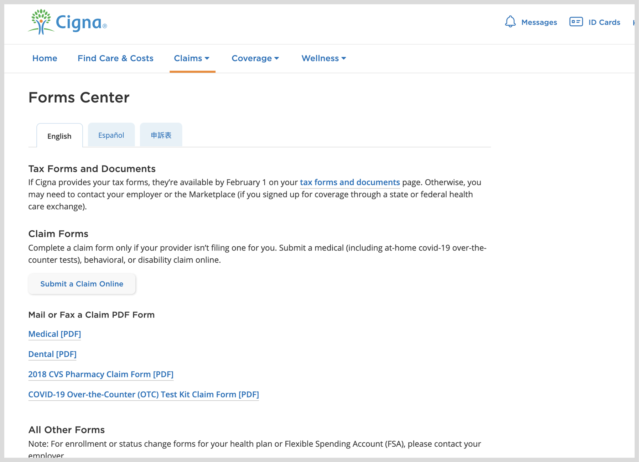
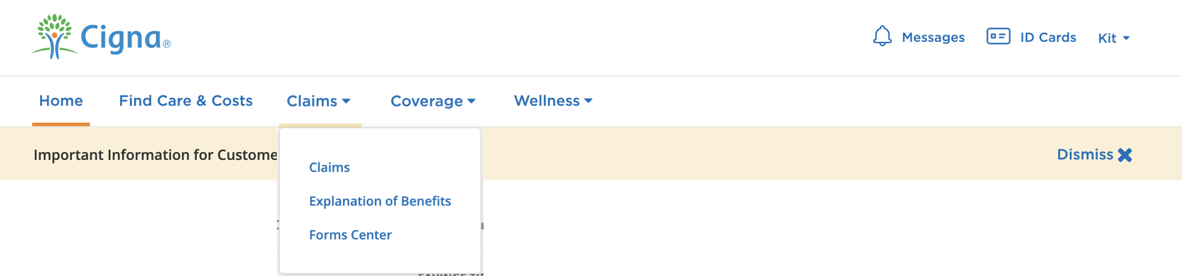
KEY THEMES
Organized navigation
From login, the site navigation presents a clear and logical click path for users to find their document.
Source: Cigna
02-01 Design Review
Comparative Research

Slide 11
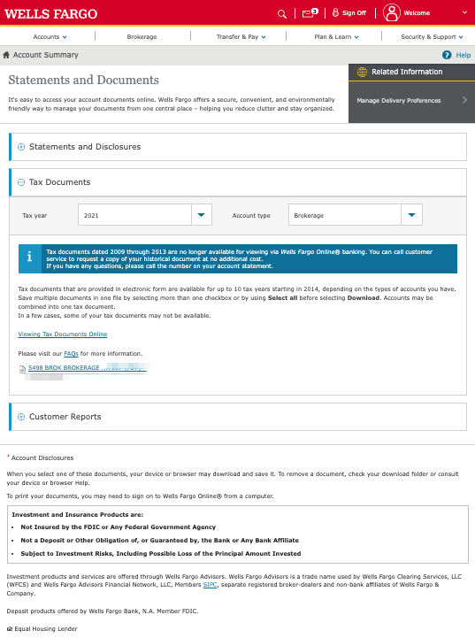
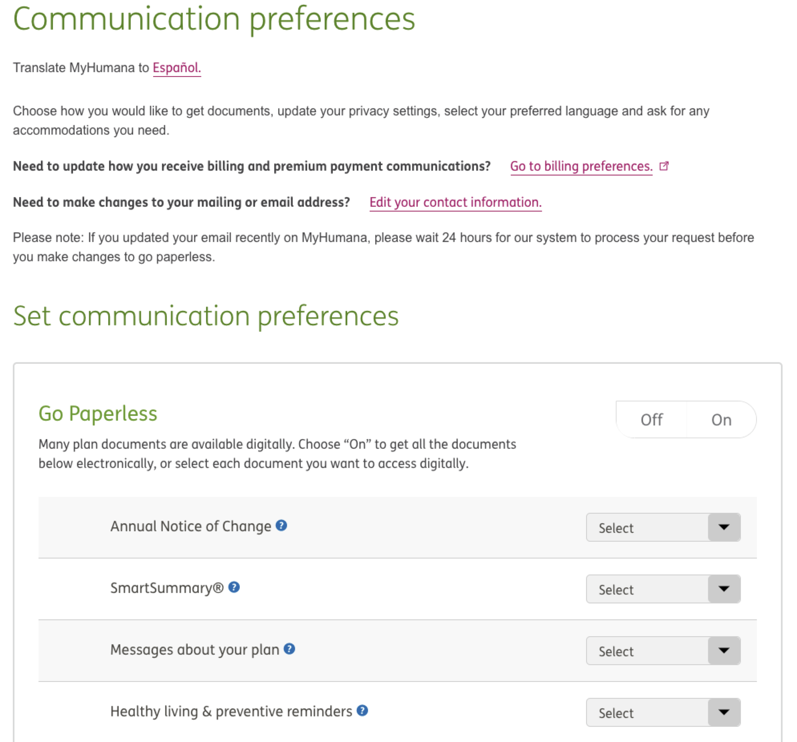
KEY THEMES
Contextual help
Quick links are often utilized for delivery preferences (if that setting is managed at a profile-level), as well as related references/key information around the document type.
Prompt(s) to opt in to paperless is associated with the relevant artifact.
If a user is already enrolled in paperless, the status is indicated to a user (as well guidance on how to adjust that setting).
Source: Humana, Wells Fargo
02-01 Design Review
Comparative Research

Slide 12

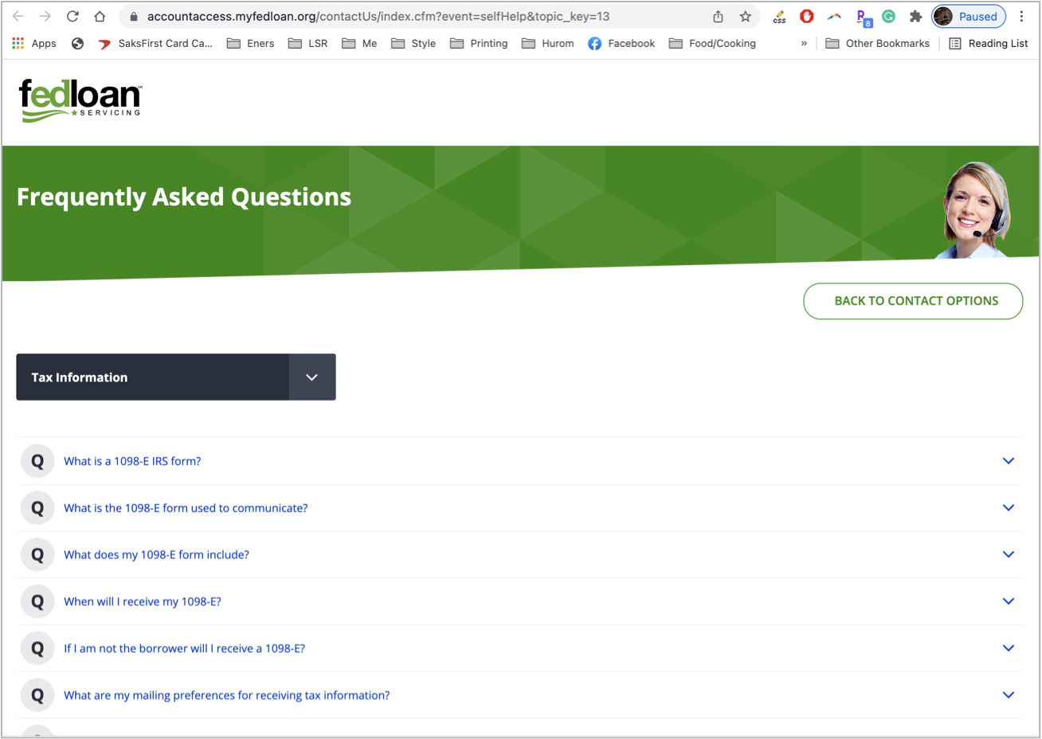
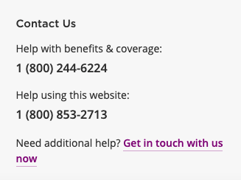
KEY THEMES
Contextual help continued
Frequently asked questions around taxes, form documents, etc. are either provided on the same page or have a quicklink for easy reference.
Help center contact information is also often provided
Source: Cigna, Humana, Fedloan Servicing
02-01 Design Review
Comparative Research

Slide 13
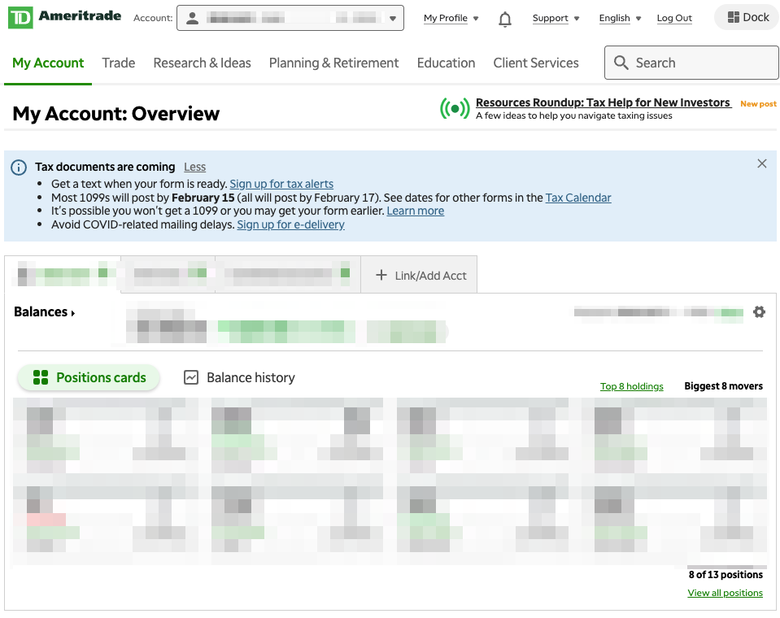
KEY THEMES
Notifications
Banners and alerts are commonly leveraged for users to quickly access newly posted tax forms
Source: TD Ameritrade
02-01 Design Review
Comparative Research

Slide 14
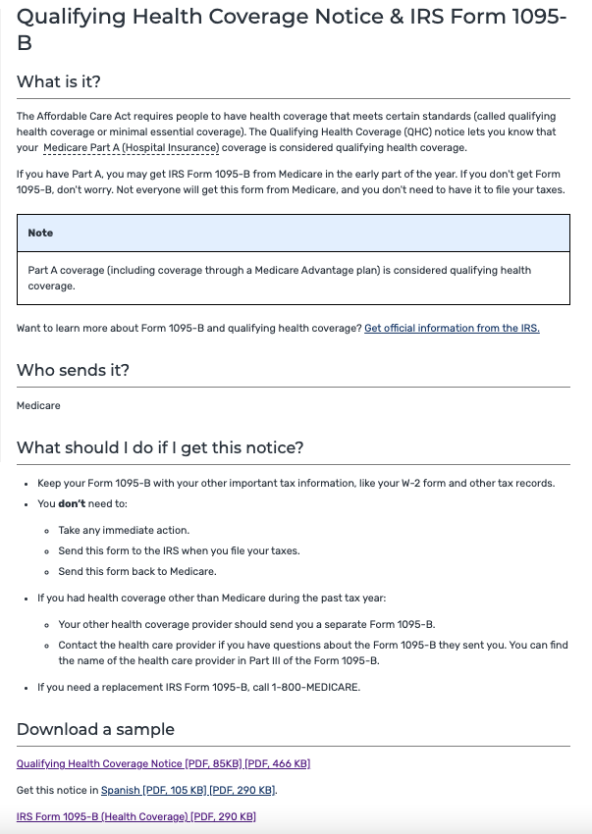
KEY THEMES
Content hierarchy
Best in class examples laid out content and information using a clear hierarchy and plain language.
Basic questions of who, what, when where answered.
Small blocks of easily digestible copy
Source: Medicare
02-01 Design Review
Comparative Research

Slide 15
COMPARATIVE RESEARCH
Key Experience Takeaways
02-01 Design Review

Slide 16
KEY EXPERIENCE TAKEAWAYS
Informed, Focused Design
As takeaways, we identified three areas of focus for this project:
Seamless User Experience – the form should be easily findable through the navigation and directed to it through relevant crosslinks.
Authenticated & Unauthenticated Experiences – an unauthenticated experience, as well as personalized content through an authenticated experience, sets user expectation that there is relevant information available upon logging in, but also helps surface FAQs earlier in their journey.
Knowledge Base & Escalation Path – anticipate user issues and questions by providing contextual help and a clear path to escalate technical issues or form errors.
02-01 Design Review
Comparative Research

Slide 17
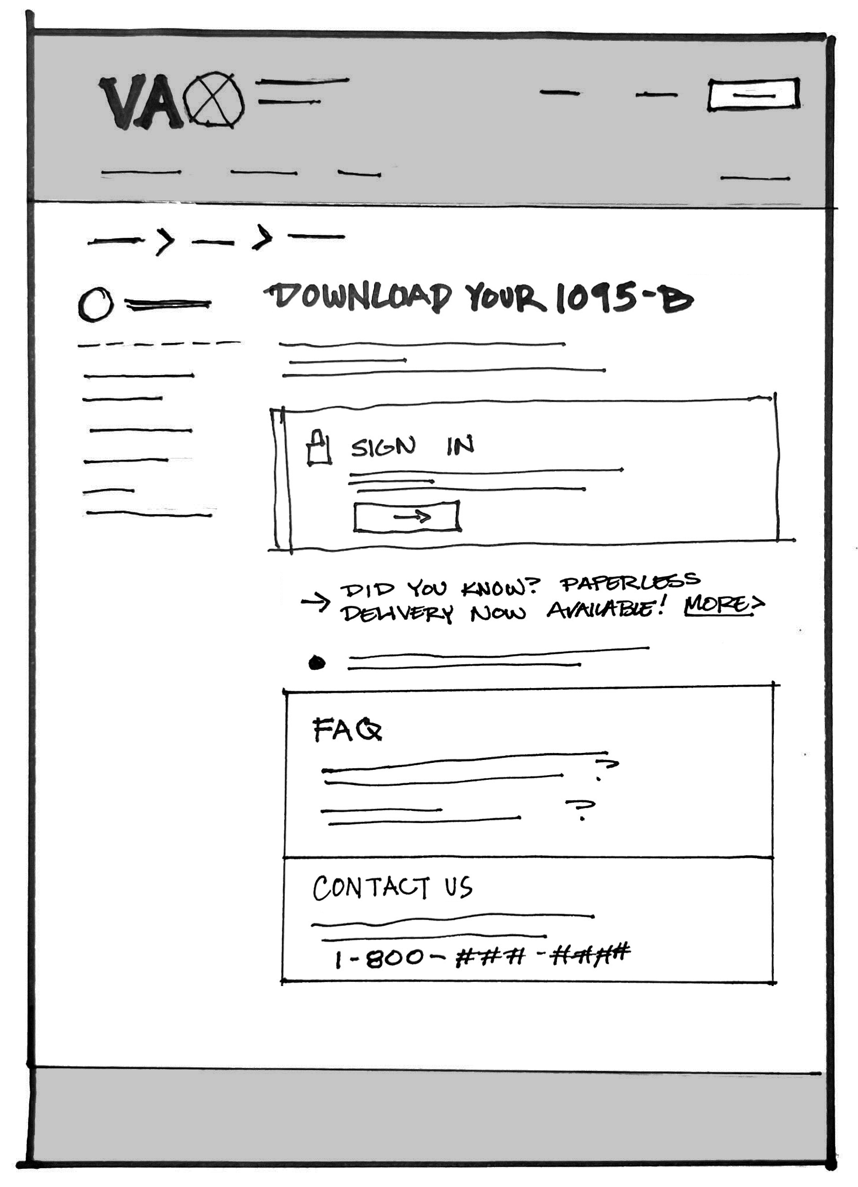
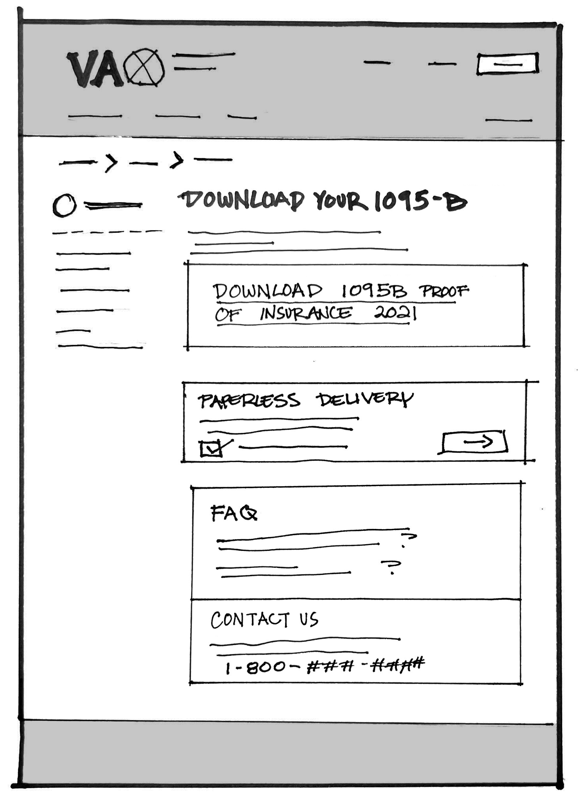
Concept Sketches
Unauthenticated (default)
Authenticated
Sketch File Here
02-01 Design Review
Comparative Research

Slide 18
Research Plan
1095-B DESIGN REVIEW
02-01 Design Review

Slide 19
Research update
Met with Shane Strassberg to review guidance on design research
Two rounds of research planned, in Sprint 2 and 3 respectively, following Platform guidelines
Initial research plan is finished, conversation guide in process. Likely to submit Wednesday or Thursday this week. Will post to GitHub and share
Sessions will be 45 minutes, with short interview in the beginning and then testing prototype?
Need to confirm participant numbers for each sprint
02-01 Design Review
Research Plan

Slide 20
Next steps
1095-B DESIGN REVIEW
02-01 Design Review

Slide 21
Next steps
Iterate on our discussion today
Ready content to submit Design Intent, followed by Research Plan
Incorporate additional findings from Tech Discovery (e.g., address management, paperless opt-in functionality)
Outline additional crosslink needs for users
02-01 Design Review
Research Plan

